Slide 1
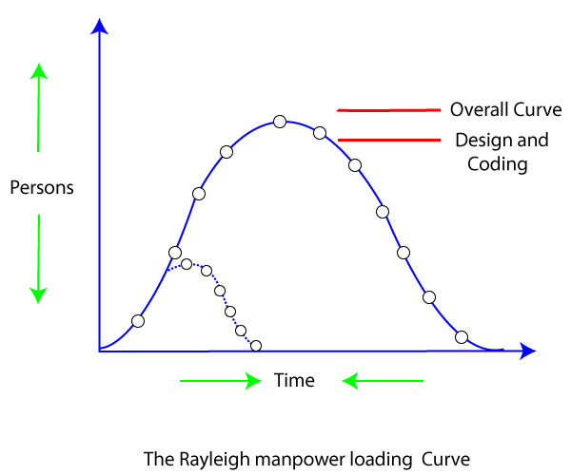
LECTURE-12 Putnam Resource Allocation Model
The Lawrence Putnam model describes the time and effort requires finishing a software project of a specified size. Putnam makes a use of a so-called the Norden/Rayleigh curve to estimate project effort, schedule & defect rate as shown in fig:

Slide 2

Putnam noticed that software staffing profiles followed the well known Rayleigh distribution. Putnam used his observation about productivity levels to derive the software equation:
The various terms of this expression are as follows:
k is the total effort expended (in pm) in product development, and l is the product estimate in kLoc .
t_{d} correlate to the time of system and integration testing. therefore, t_{d} can be relatively considered as the time required for developing the product.
c_{k} is the state of technology constant and reflects requirements that impede the development of the program.
typical values of c_{k} = 2 for poor development environment
c_{k}= 8 for good software development environment
c_{k} = 11 for an excellent environment (in addition to following software engineering principles, automated tools and techniques are used).
The exact value of c_{k} for a specific task can be computed from the historical data of the organization developing it.

Slide 3
Putnam proposed that optimal staff develop on a project should follow the Rayleigh curve. Only a small number of engineers are required at the beginning of a plan to carry out planning and specification tasks. as the project progresses and more detailed work are necessary, the number of engineers reaches a peak. After implementation and unit testing, the number of project staff falls.
Effect of a schedule change on cost :

Slide 4
For example, if the estimated development time is 1 year, then to develop the product in 6 months, the total effort required to develop the product (and hence the project cost) increases 16 times.
QUESTIONS :
Explain the Putnam resource allocation model. What are the limitations of this model?
Write below the Putnam Expression ?
What is Rayleigh curve in software engineering?
What is staffing level estimation in software engineering?

